Slide 1
Fitness Dependent Optimizer: Inspired by the Bee Swarming Reproductive Process
Author Names:
1. JAZA MAHMOOD ABDULLAH
2. TARIK AHMED RASHID
Guided By:
Mr. B. Srinivasan, B.E., M.Tech.,
School of Computing, AP-III, IT, SASTRA University
srinivasan@core.sastra.edu
Published in IEEE Access ( Volume: 7 )
Date of Publication: 22 March 2019
Publisher: IEEE
DOI: 10.1109/ACCESS.2019.2907012
Scopus Index: 21100374601
Presented by:
1. Surya Narayanan S (121015098)
suryan0800@gmail.com
Mini-Project Members:
2. Preethi T (121015078)
preethitamilvendan@gmail.com
3. Raghunathan MS (121015081)
bargav32@gmail.com

Slide 2
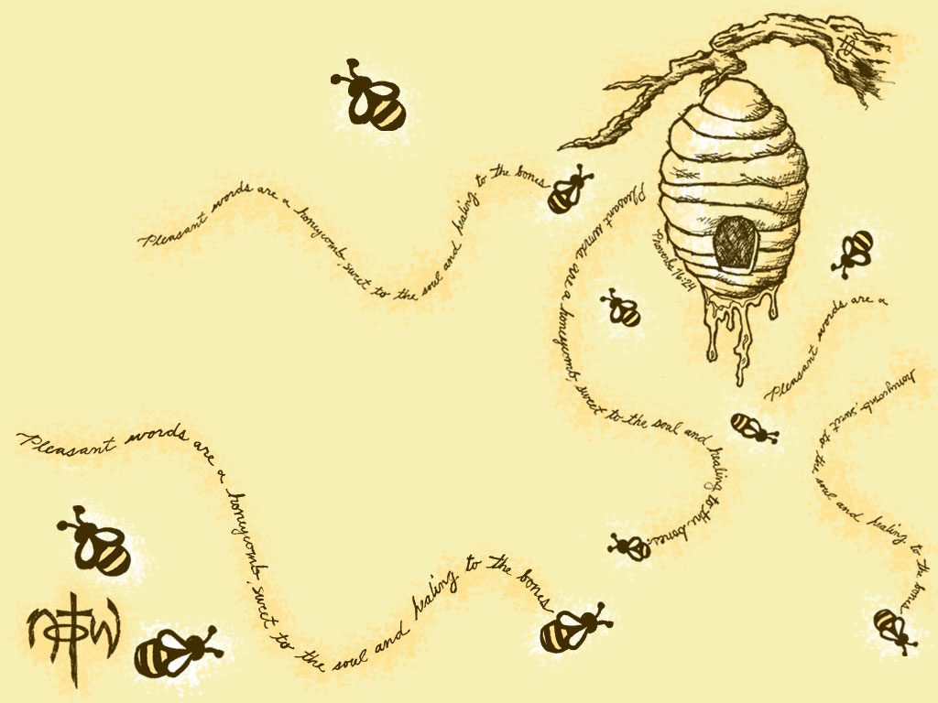
Index
Introduction
Abstract
Bee Swarming process
FDO Algorithm
Flow Chart of FDO
Result (comparison with other algorithm)
Real world Applications

Slide 3
Introduction
Optimization ? (solution search algorithm)
Swarm intelligence ? (collective knowledge)
Evolutionary computation ? (nature inspired)
Metaheuristic algorithms ? (self learn from experience)
Fitness value? (how optimal is the current solution)
Pace? (Velocity of movement from one feature set to another)
Feature Set ? (parameters)
Search Space, X ? (parameters, range)
Random number, r?
Fitness weight ?
Dimension/Feature ? (each parameter)

Slide 4
Abstract
To solve solution searching problems with large search area.
We find (search) optimal feature based on the fitness value and Pace.
Bee swarm collective decision-making inspired.
Trial and error.
Hopes of good quality.
Corrects its mistake.
19 classical benchmark test functions.
Results with Particle Swarm, Genetic and, Dragonfly.

Slide 5
Continued..
IEEE Congress of Evolutionary Computation Benchmark Test Functions (CECC06, 2019 Competition).
Results with Dragonfly(DA), the whale optimization(WOA), and the salp swarm (SSA) algorithm.
FDO stability (exploration and exploitation phases).
major contributions : generating suitable weights, past search agent pace, PSO-based algorithm.
Real-world application.

Slide 6
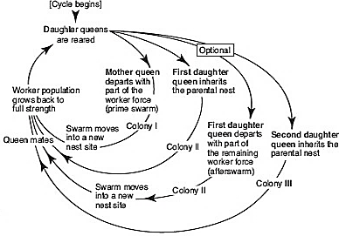
Bee Swarming Process

Slide 7
Inspired Natural Process
Swarming - by which new honeybee colony is formed.
send 20-50 scout bees - to find suitable new hives.
Eventually, with the guidance from the scouts,
the rest of the bees flying overhead in the proper direction.
several criteria for a suitable hive.
Ex large enough to accommodate.
scouts' collective decision making processes.
choose the most suitable hive, keep the swarm intact.
bee dance (moving their legs and wings) .
decision will be made when approximately 80% of the scouts have agreed upon a certain hive location.
Nature | Algorithm
Scout bee | Search agent
Hive | Solution discovered
Hive Specification | Fitness function
Scout collective decision | Fitness Weight
Selected hive | Optimum Solution

Slide 8
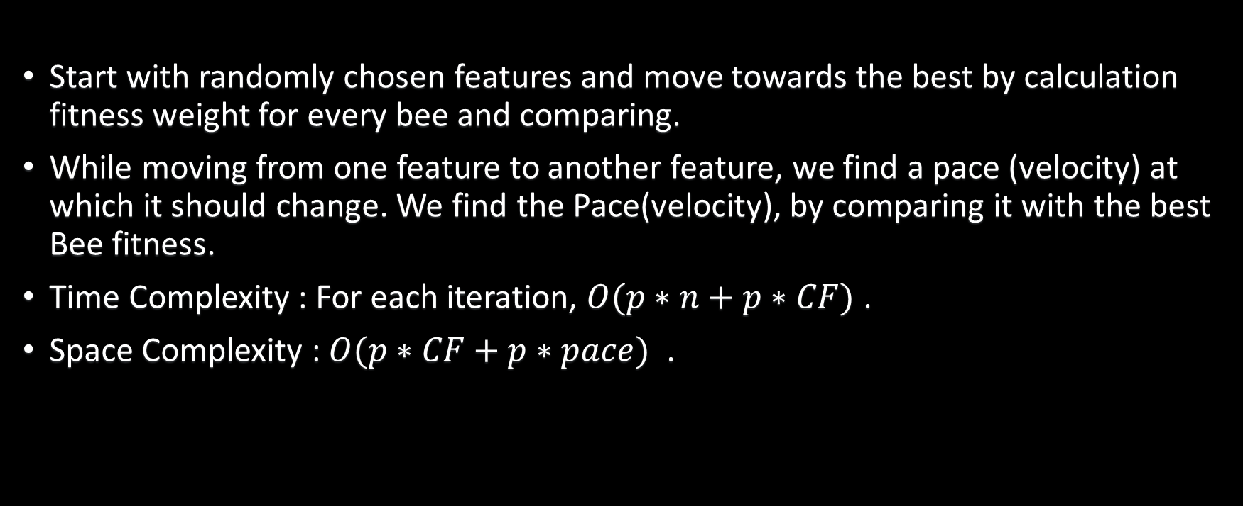
FDO Algorithm
Start with randomly chosen features and move towards the best by calculation fitness weight for every bee and comparing.
While moving from one feature to another feature, we find a pace (velocity) at which it should change. We find the Pace(velocity), by comparing it with the best Bee fitness.
Time Complexity : For each iteration, $O(p∗n+p∗CF)$ .
Space Complexity : $O(p∗CF+p∗pace)$ .

Slide 9

FDO Formula
$x_{i}$(i= 1, 2, . . .n);
$x_{i,t+1}$= $x_{i,t}$+ pace
$fw=\left|\frac{x_{i,t fitness}^{∗}}{x_{i,t fitness}}\right|− wf$
$\left\{\begin{matrix}fw=1 or fw=0 or x_{i,t fitness}=0,pace= x_{i,t} ∗r \\ fw>0 and fw<1 \left\{\begin{matrix}r<0, pace= \left(x_{i,t} − x_{i,t}^{∗}\right) ∗fw ∗( − 1) \\ r≥0, pace= \left(x_{i,t} − x_{i,t}^{∗}\right) ∗fw \end{matrix}\right\}\end{matrix}\right\}$

Slide 10
Flow Chart
Select N random Points (feature set)(scout bees)
No
Find Best Points (Scout Bee) using fitness value
Yes
Still more points or still more iterations
Find Pace, new fw using Best Bee Fitness value
No
Yes
Update new Points using Pace
Yes
Yes
fw_{i, t+1} > fw_{i, t}
fw_{i, t+1} > fw_{i, t}
No
Yes
Using previous best Pace, find fw
Random Walk
No
fw_{i, t+1} > fw_{i, t}
Note : fw – Fitness Value, pace – how far the point is moved

Slide 11
Result with other Algorithms
Comparison with Particle Swarm Optimization algorithms like:
Genetic algorithm (GA),
Dragonfly algorithm (DA) and
Whale Optimization algorithm (WOA) .
As a result, in some cases, it outperforms these algorithms and performs comparably in other cases.
Comparatively quicker than traditional algorithms like Gradient-based and quadratic algorithms.

Slide 12
CLASSICAL BENCHMARK TEST FUNCTIONS
unimodal test functions – Exploitation and convergence test – single optimal solution.
multimodal test functions – multiple optimal solution – avoid local optimal and converge to global optimal.
And composite test functions - combined, shifted, rotated, and biased versions of other test functions.
tested 30 times.
by using 30 search agents each with 10 dimensions.
In 500 iterations .
then, the average fitness and standard deviation were calculated.

Slide 13
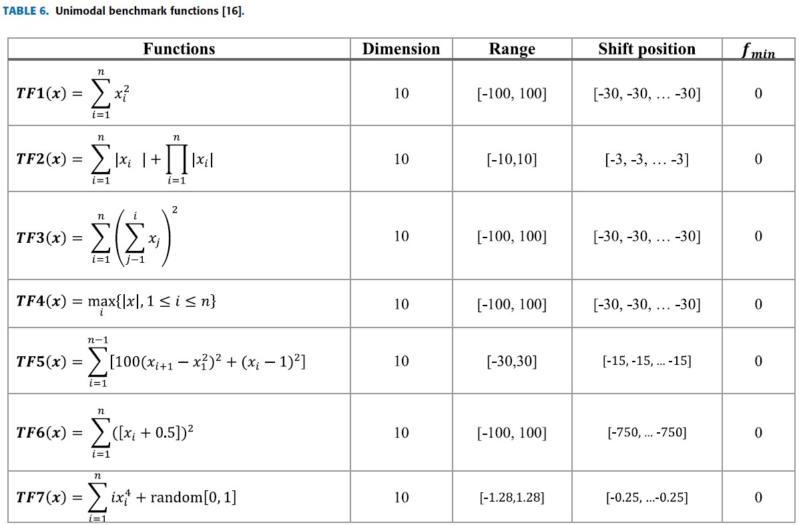
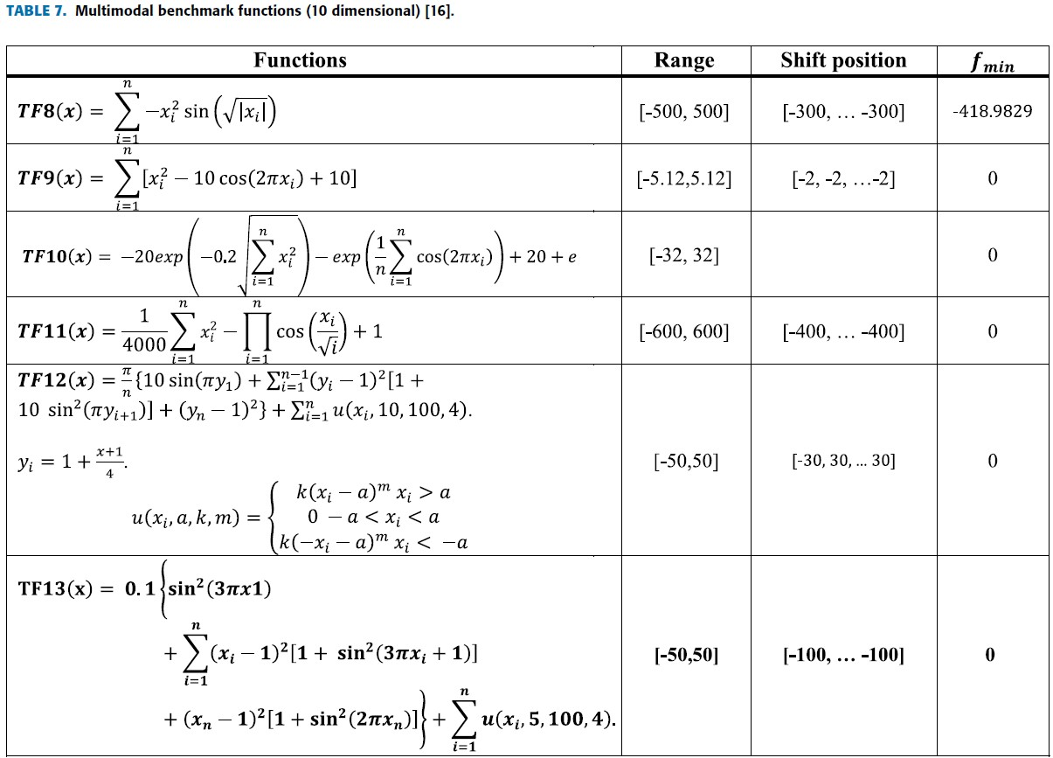
Test Functions

Slide 14
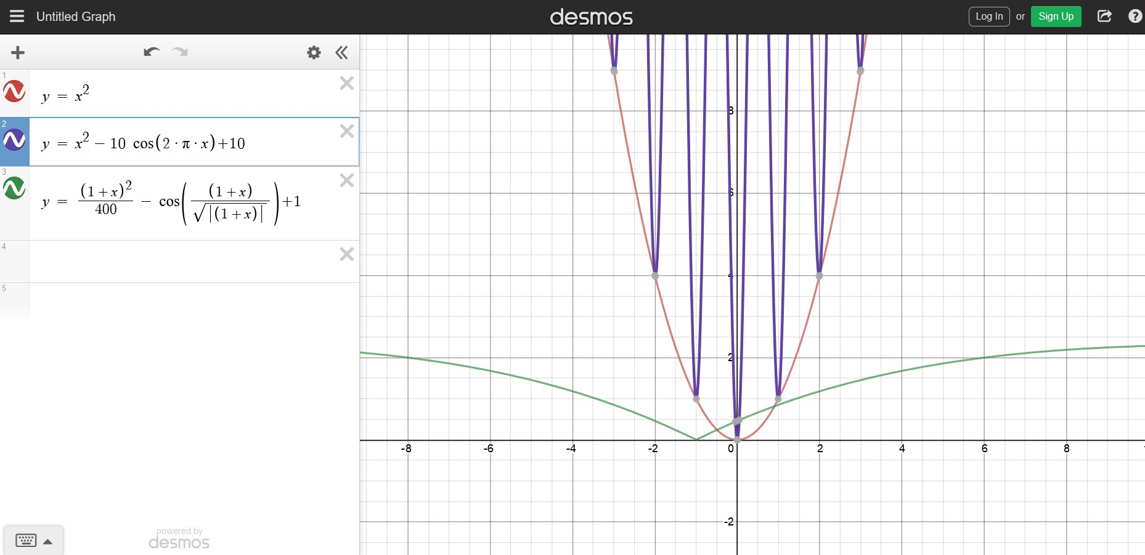
Test Function graph

Slide 15
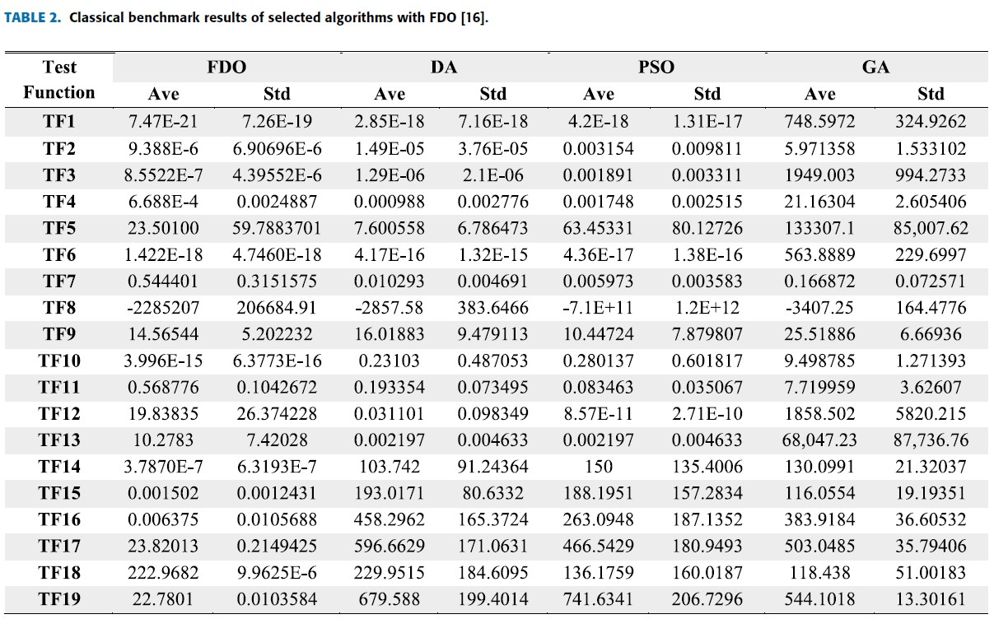
Comparison table

Slide 16
CEC-C06 2019 BENCHMARK TEST FUNCTIONS
IEEE Congress of Evolutionary Computation Benchmark Test Functions (CECC06, 2019 Competition) .
“The 100-Digit Challenge “ - by professor Suganthan .
10-dimensional minimization problem in [-100, 100] boundary range .
500 iterations using 30 agents .

Slide 17
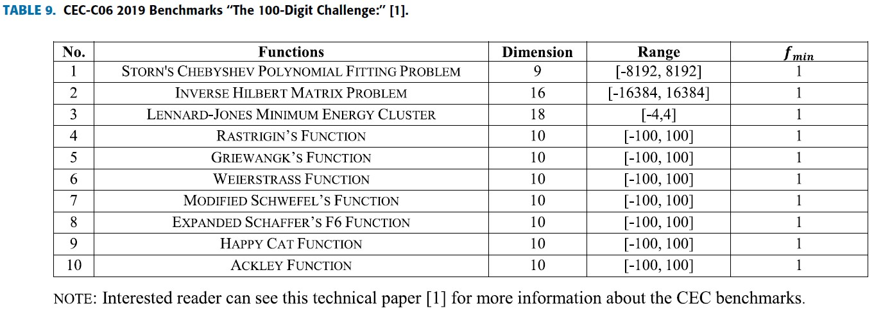
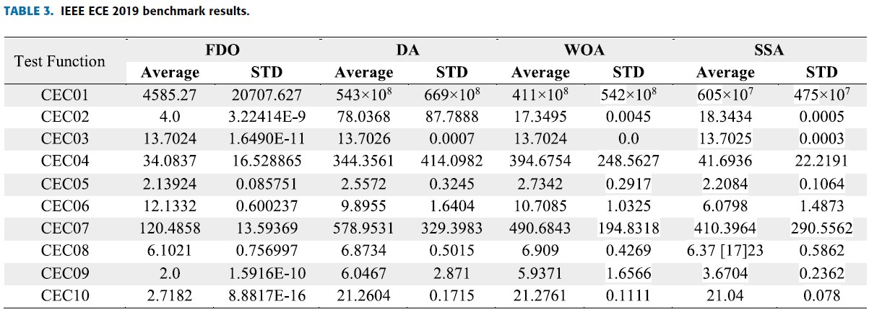
CEC Test Functions

Slide 18
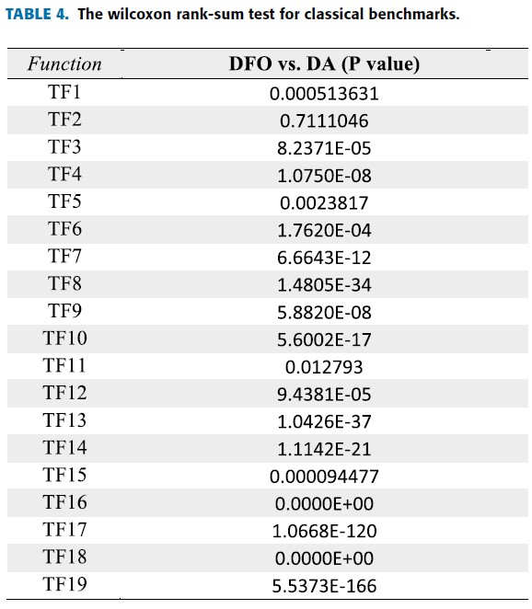
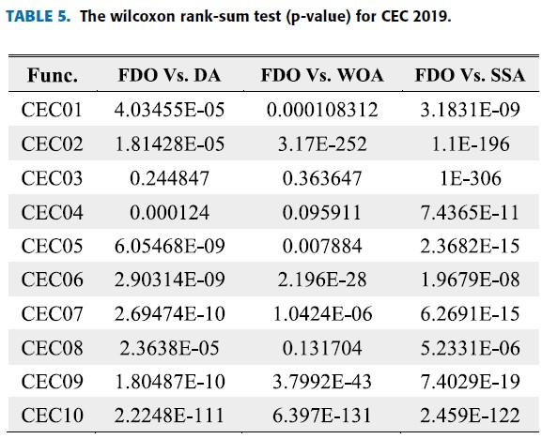
STATISTICAL TESTS – Wilcoxon Rank Sum

Slide 19
QUANTITATIVE MEASUREMENT METRICS
using 10 search agents.
two-dimensional landscape through 150 iterations.
First metric - convergence .
Second metric - measures the value of the search agent (fitness function value)
Third Metric - average Fitness value of all FDO agents decreased dramatically over
Fourth metric - measures the convergence of the global best agent through the course of the iteration.

Slide 20
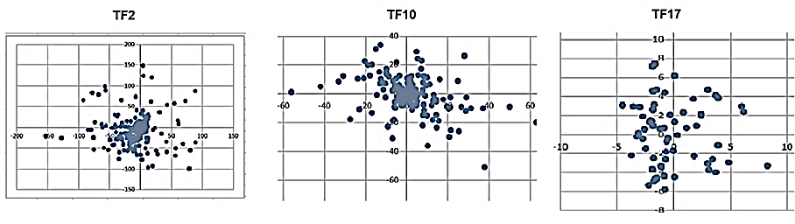
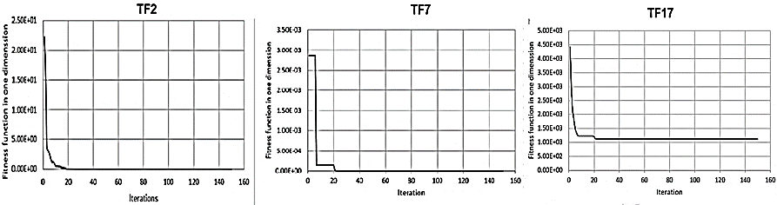
Result Graph

Slide 21
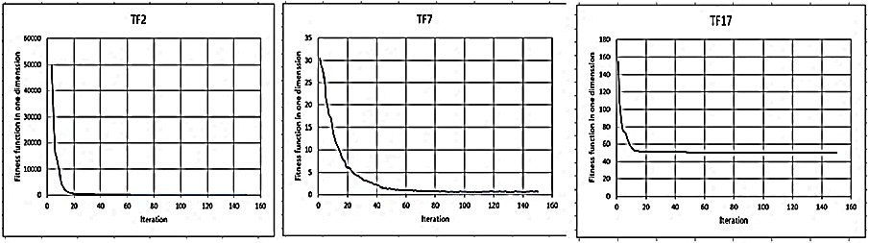
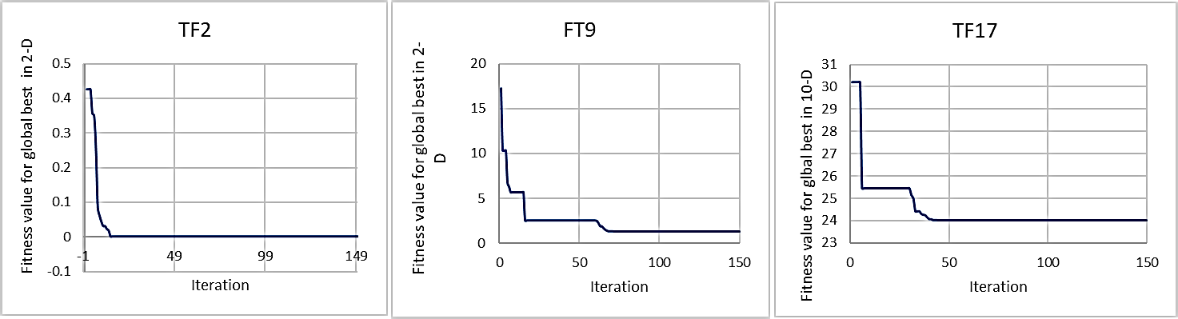
Continued.. Result Graph

Slide 22
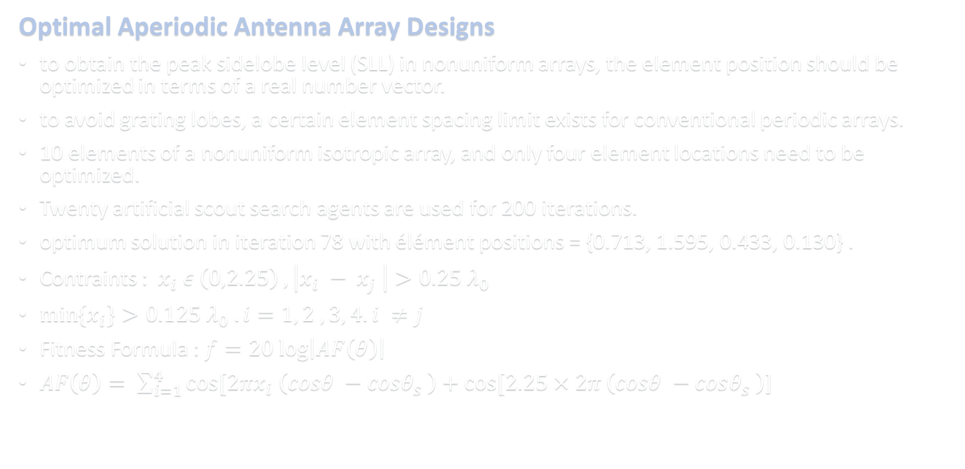
Real World Applications
Optimal Aperiodic Antenna Array Designs
to obtain the peak sidelobe level (SLL) in nonuniform arrays, the element position should be optimized in terms of a real number vector.
to avoid grating lobes, a certain element spacing limit exists for conventional periodic arrays.
10 elements of a nonuniform isotropic array, and only four element locations need to be optimized.
Twenty artificial scout search agents are used for 200 iterations.
optimum solution in iteration 78 with élément positions = {0.713, 1.595, 0.433, 0.130} .
Contraints : $x_{i} ε \left(0,2.25\right) ,\left|x_{i} − x_{j} \right|>0.25 λ_{0}$
$\min{\{x_{i}}\}>0.125 λ_{0} . i=1, 2 ,3, 4. i ≠j$
Fitness Formula : $f=20 log\left|AF\left(θ\right)\right|$
$AF\left(θ\right)= \sum_{i=1}^{4}{cos[2πx_{i} \left(cosθ −cosθ_{s} \right)+cos[2.25×2π}\left(cosθ −cosθ_{s} \right)$]

Slide 23
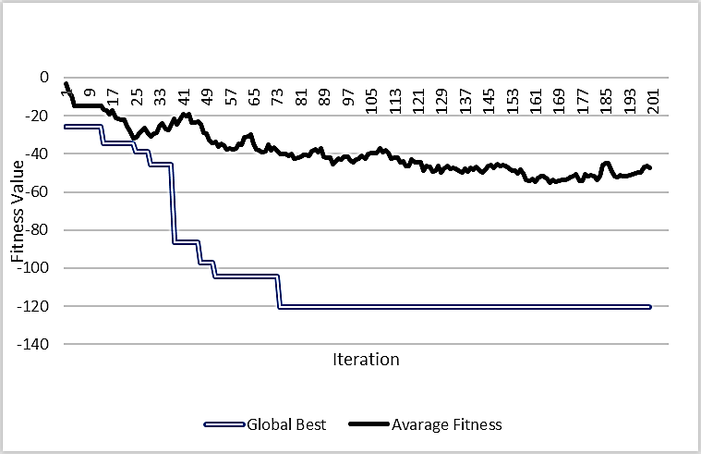
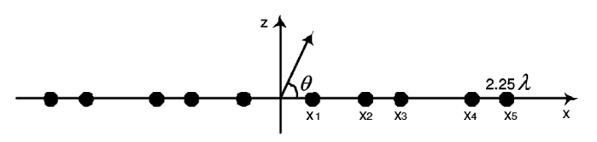
Result graph

Slide 24
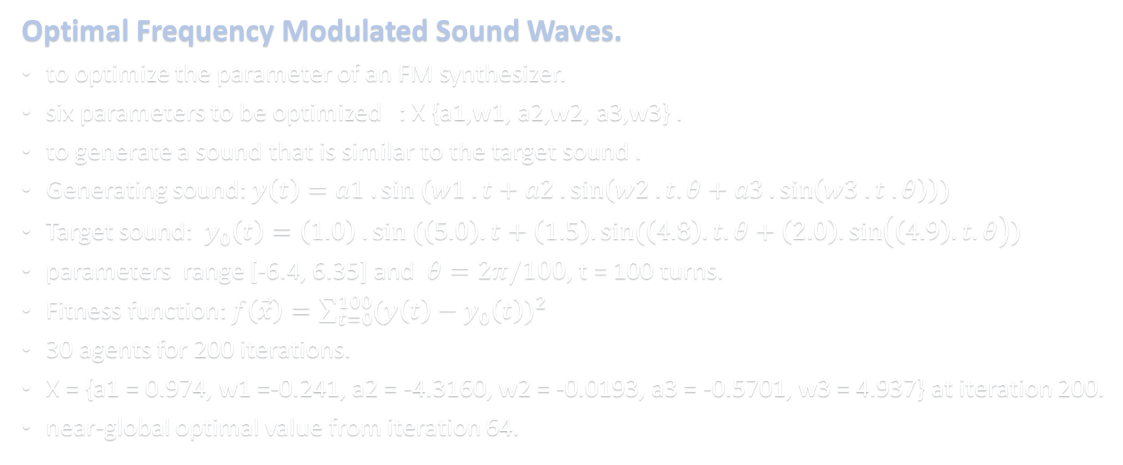
Continued..
Optimal Frequency Modulated Sound Waves.
to optimize the parameter of an FM synthesizer.
six parameters to be optimized : X {a1,w1, a2,w2, a3,w3} .
to generate a sound that is similar to the target sound .
Generating sound: $y\left(t\right)=a1 . sin (w1 . t+a2 .\sin\left(w2 . t. θ+a3 .\sin\left(w3 . t . θ\right)\right))$
Target sound: $y_{0}\left(t\right)=\left(1.0\right) . sin (\left(5.0\right).t+\left(1.5\right).sin(\left(4.8\right).t.θ+\left(2.0\right).\sin\left(\left(4.9\right).t.θ\right))$
parameters range [-6.4, 6.35] and $θ=2π/100$, t = 100 turns.
Fitness function: $f\left(\vec{x}\right)=\sum_{t=0}^{100}{{(y\left(t\right)−y_{0}\left(t\right))}^{2}}$
30 agents for 200 iterations.
X = {a1 = 0.974, w1 =-0.241, a2 = -4.3160, w2 = -0.0193, a3 = -0.5701, w3 = 4.937} at iteration 200.
near-global optimal value from iteration 64.

Slide 25
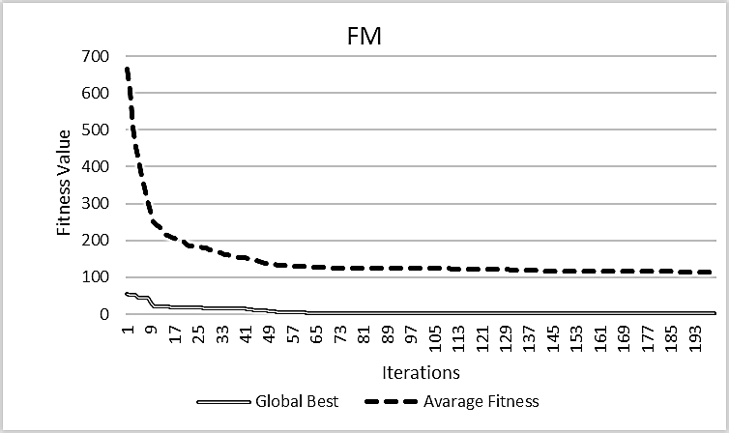
Result graph

Slide 26
References
M. Melanie, An Introduction to Genetic Algorithms. Cambridge, MA, USA: MIT Press, 1999.
S. Mirjalili, ``Dragonfly algorithm: A new meta-heuristic optimization technique for solving single-objective, discrete, and multi-objective problems,‘’ Neural Computer Appl., vol. 27, no. 4, pp. 10531073, May 2015.
S. Mirjaliliab and A. Lewisa, ``The whale optimization algorithm,'' Advanced Eng. Software., vol. 95, pp. 5167, May 2016.

Slide 27
THANK YOU!

